Slide 1




USED VEHICLE PRICE PREDICTION
Sanjay Jaras, Satish Agrawal
DSC-630
Bellevue University

Slide 2
Introduction and problem statement
Price of a used vehicle is very important and needs to be consistent and fair.
There are a variety of factors that impact the price of a used vehicle.
This project uses a dataset with various features about the vehicles listed and sold in the past and attempts to predict a price for new listings.
This will be useful in coming up with a fair price of the used vehicles, keeping the margin and market conditions in mind.

Slide 3
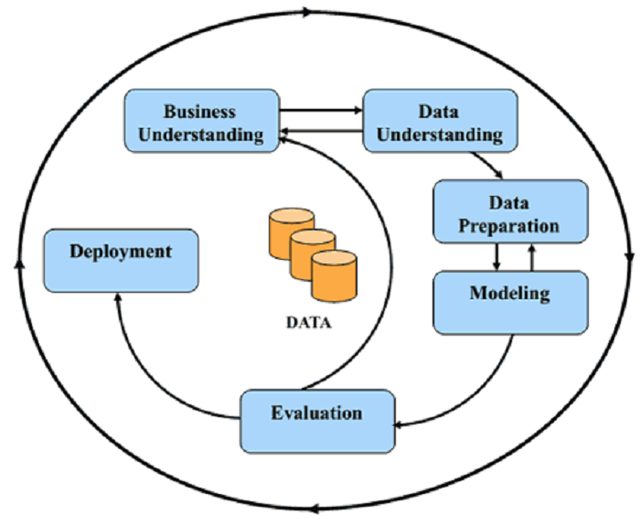
MAJOR STEPS
Data understanding
Split the data set into train and test set
Exploratory analysis of the data set
Data cleaning and preparation
Feature selection and feature engineering
Exhaustive model training
Model evaluation and selection
Testing with test data
Discuss the best model and Model deployment

Slide 4
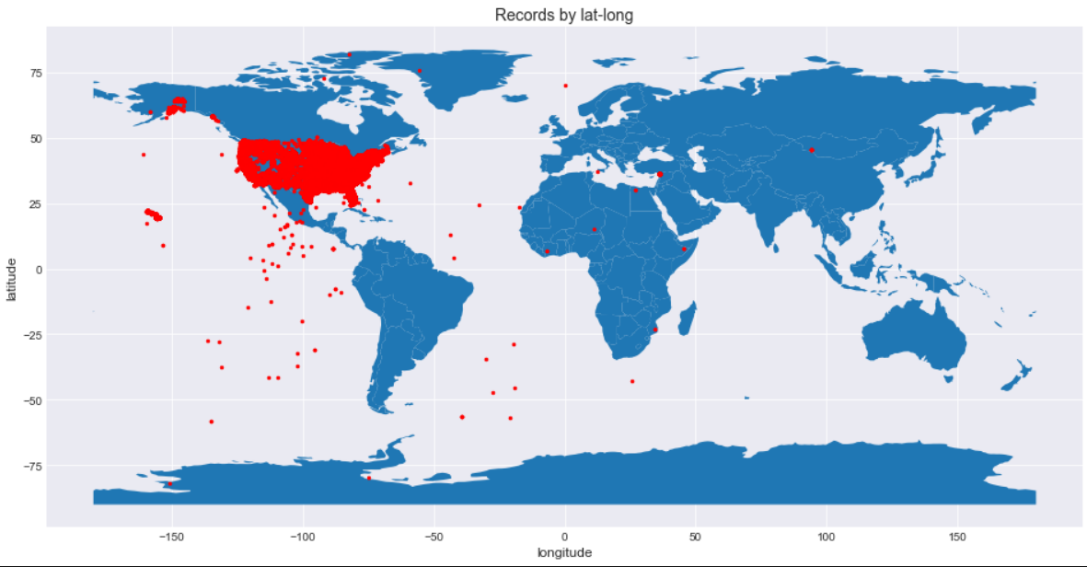
The dataset used in this analysis is from Craigslist and has more than 458K observations of used vehicle listings.
There are 25 attributes in the data set for each listing.
The price for the vehicle is in the dataset and is our target variable that we are trying to predict using machine learning models.
Key attributes are odometer, make and model, year, fuel type, and transmission.
We kept 20% of the data aside for testing the model trained on 80% of the dataset.
Dataset

Slide 5
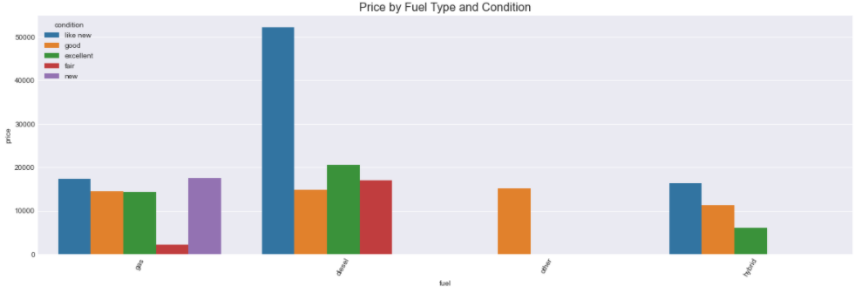
We performed EDA on most of the attributes to understand the distribution and find any correlations with the target variable.
The figures here shows the correlation of condition and fuel type with the target variable, the price of the vehicle.
We generated a correlation matrix between all the numeric attributes to see the impact of individual variables on the target variable.
We analyzed values for categorical variables for anomalies and inconsistencies.
EXPLORATORY DATA ANALYSIS

Slide 6
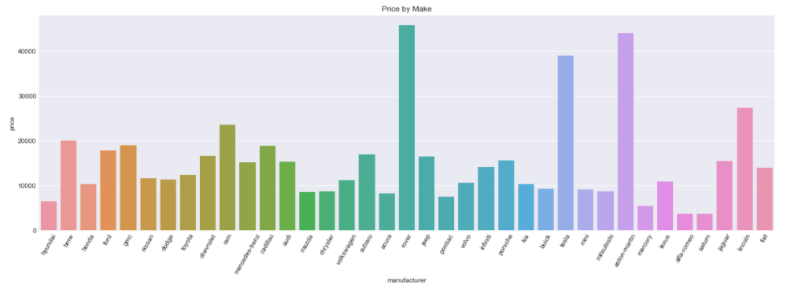
EXPLORATORY DATA ANALYSIS
Another graph here shows the variations in the price by the manufacturer of the vehicle.
Graph clearly shows that the manufacturer of the vehicle impacts the price. Rover, Aston Martin and Tesla have higher average price than Hyundai and Saturn.
Dataset has variety of manufacturers and good coverage on price range for those all.

Slide 7
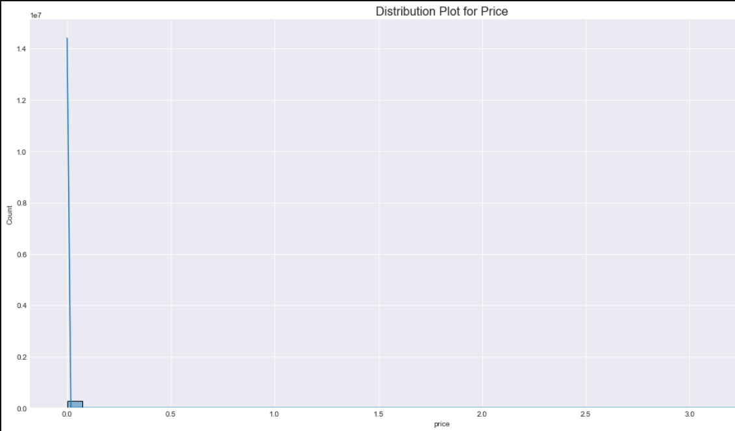
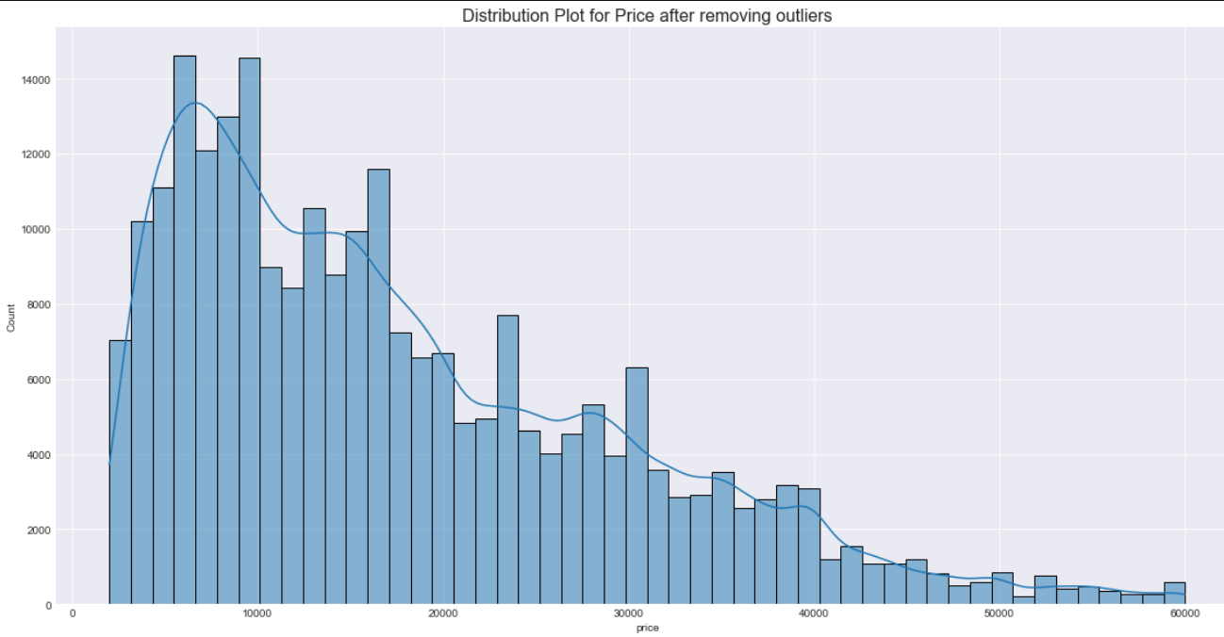
Data cleaning and preparation
We removed the outliers from price, year, and odometer.
Above graphs show the distribution before and after outlier removal for price.
We identified and imputed missing values using iterative imputer with Lasso Regressor.
We also removed the feature “size” because it has more than 50% missing values and may not be as helpful in price prediction.

Slide 8
Feature selection and engineering
We removed the following attributes from the dataset, considering they do not have any correlation with the target variable or highly correlated with other features and are duplicates :
URL
ID
Image_URL
Description
Region_URL
VIN
These features do not have any correlation with the price of the car and may not contribute towards making the price prediction
We also removed "state" feature as it has small correlation with target variable.
We used model year and listing date to derive the age of the car at the time of listing. Age has an important role to play in price prediction.

Slide 9
Training models
Training is the process of applying available data to the chosen algorithm(s).
We chose to train Linear regressor, DecisionTreeRegressor, XGBRegressor, Kneighbours Regressor, Lasso, Ridge and RandomForestRegressor models.
Training multiple models allow comparing and choosing the best performing model.
We employed an exhaustive search technique to train multiple models for the same algorithm and tune the hyperparameters to come up with the best model.
We ended up training 280 models in total with cross-validation.

Slide 10
Model selection and scoring metrics
Model selection is the process of selecting the best performing model with the best hyperparameters
Scoring metrics allow comparing assorted models.
There are many scoring metrics to choose from including Max error, r-square, explained variance, accuracy, F1 score, etc.
We chose accuracy to be the scoring metrics for our model evaluation and selection process.
K-fold cross-validation splits data into K-folds and uses K-1 folds to train a model and remaining one-fold to validate the performance using the metric provided.
We used 5-fold cross-validation.

Slide 11
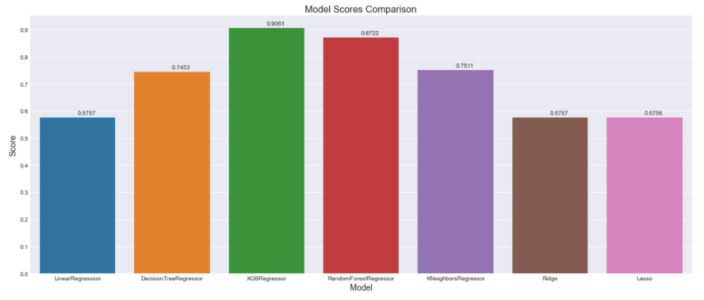
Comparing Models
Seven different models trained with different hyperparameters
Above graph shows the accuracy of each model with best parameters
XGB regressor gives the best results with 90.61% accuracy
We have pipeline built and can try other models and parameters to see if performance can be improved

Slide 12
MAJOR CHALLENGES AND RESOLUTIONS
Though the dataset has around 485k observations only, we have many categorical features with a long list of supported values, one hot encoding has increased the number of attributes in the set and was crashing the program while training.
Dataset has many categorical attributes. Using one-hot encoding was making model overfit.
As we split the dataset before in hand, we saw missing categories in the training dataset which were present in the test dataset.
To avoid the above issue, we delayed the split of the dataset which was potentially introducing data snooping issues to the project.
We found that sklearn has a newer version 0.24 where this has been handled and it worked fine for us.

Slide 13
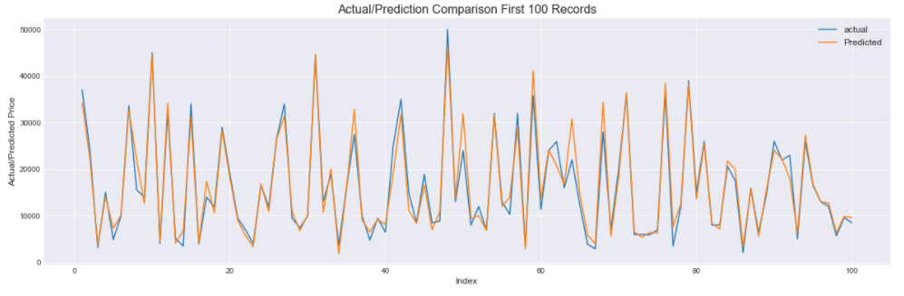
The selected model is 93.42% accuracy in used vehicle price prediction on the test data.
Graph above shows predictions are accurate or close to the actual price for the vehicles.
If we have other features like improvements to the vehicle or accessories added, would help improvise the prediction.
This model can be deployed in a production environment and be used in real world scenario to predict the fair price.
Outcome and next steps

Slide 14
Thank You !

